Slide 1
Machine learning

Slide 2
topics
INTRODUCTION
SUPERVISED LEARNING
DECISION TREES
UNSUPERVISED LEARNING

Slide 3
introduction
WHAT IS MACHINE LEARNING ?
Giving computers the ability to "learn" with data, without being EXPLICITLY PROGRAMMIMG

Slide 4
MOTIVATION FOR ML

Slide 5
It is hard to write programs for certain tasks
-human face detection
-handwriting detection
-playing complex games like chess
-recommending movies that a person will like

Slide 6
Why?
We do not ourselves know how to solve the problem
Programs will be too complicated
Too many instances of the program needed

Slide 7
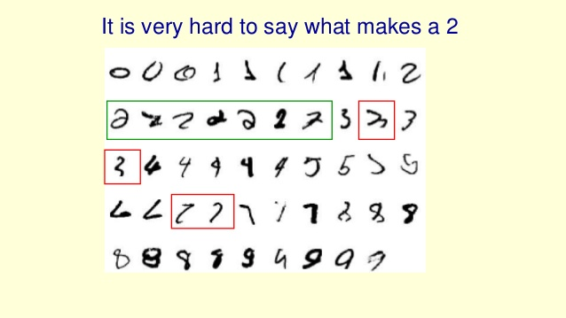
A classic example - recognising numbers

Slide 8
Solution - machine learning
Instaed of writing programs by hand, collect lots of examples that specify the correct output for the specified input
A machine learning algo takes these examples and produce a program that does the job
If done right, the program works for new cases as well as the ones we trained it on

Slide 9
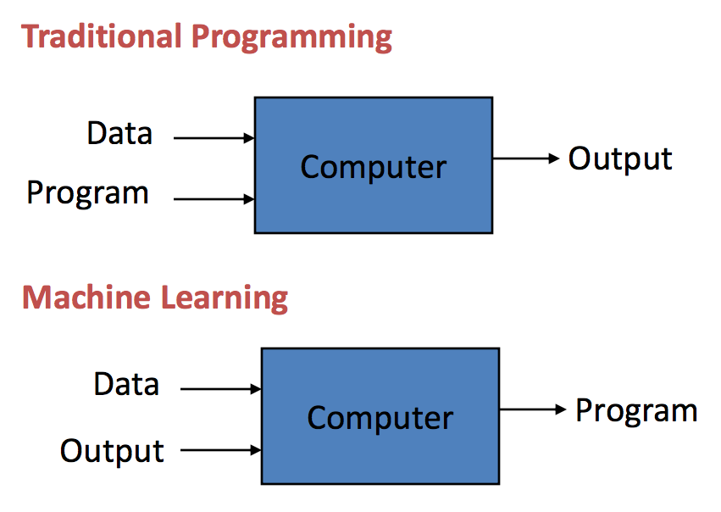

Slide 10
Some more problems best solved
by machine learning
Recognizing patterns --[facial identites, medical images, spoken words]
Recognizing anaomalies --[unusual sequences of credit card transactions]
Prediction --[future stock prices, currency exchange rates]

Slide 11
Types of learning
Supervised learning
[Training data includes desired / correct outputs]
Unsupervised learning
[Training data does not include desired outputs]

Slide 12
Supervised learning
Linear Regression
(single & multiple variable)
Classification
(logistic regression, decision tree, support vector machines,etc.)
Neural networks

Slide 13
Linear regression
Dataset - “right answers” given
Train the model to predict results for new data
Predict continuous valued output

Slide 14
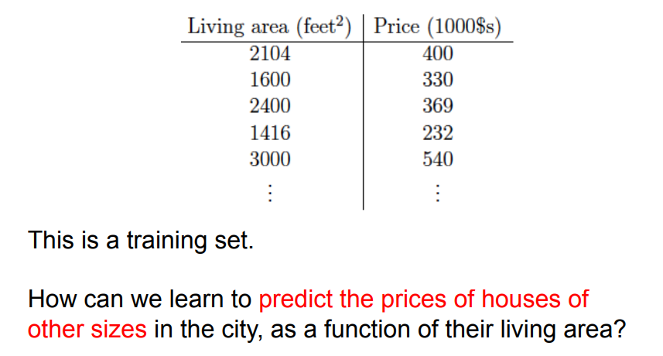
Linear regression with single variable

Slide 15
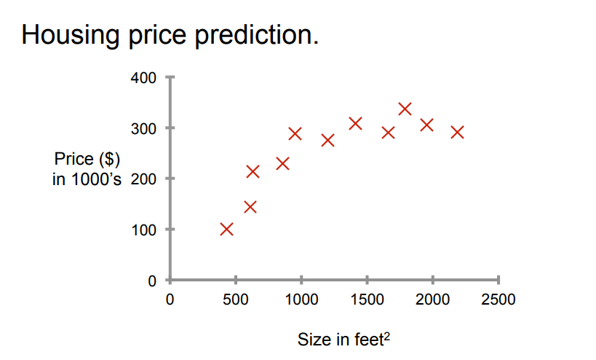
Linear regression with single variable

Slide 16
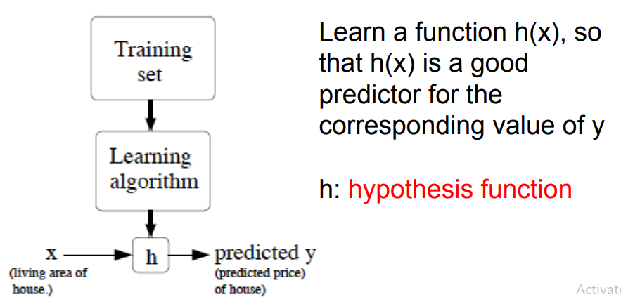
Linear regression with single variable

Slide 17
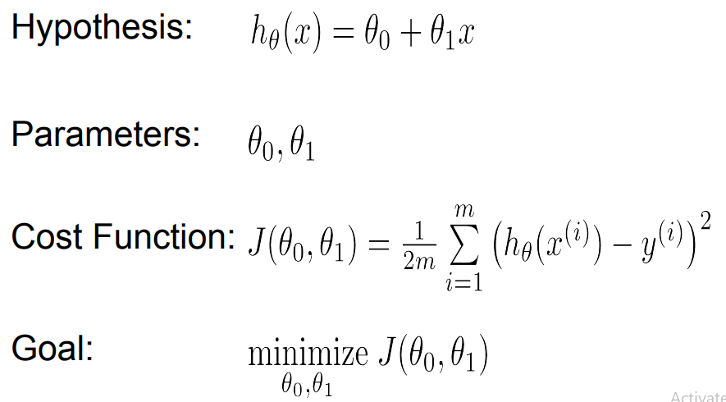
Linear regression with single variable

Slide 18
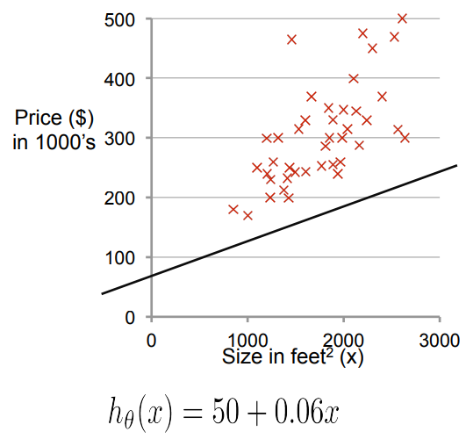
Linear regression with single variable

Slide 19
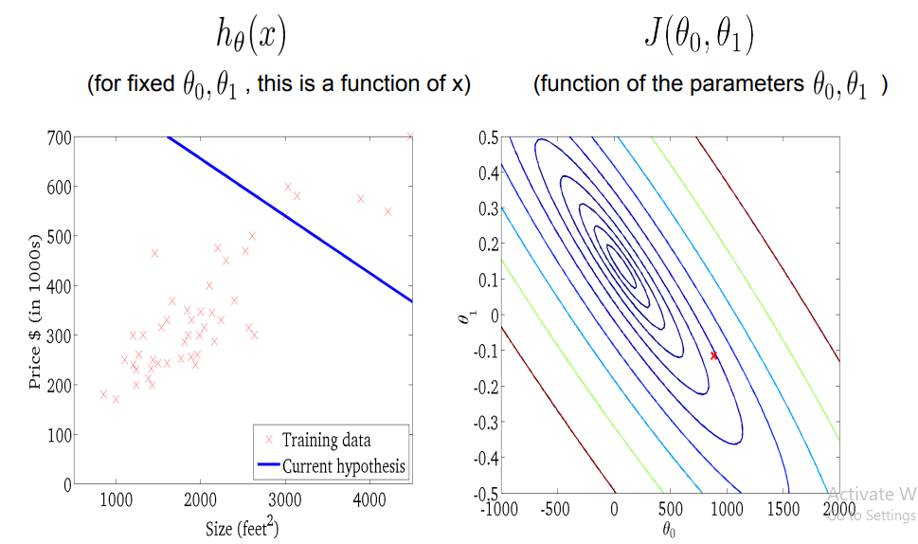
Linear regression with single variable

Slide 20
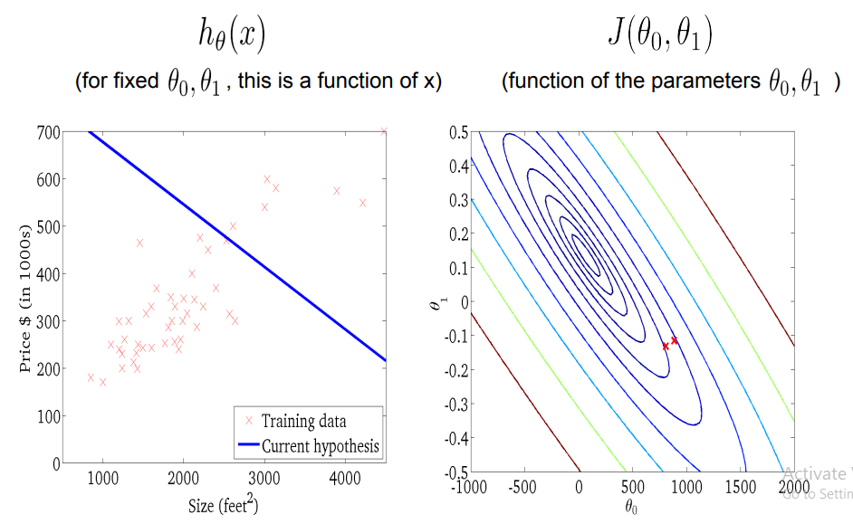
Linear regression with single variable

Slide 21
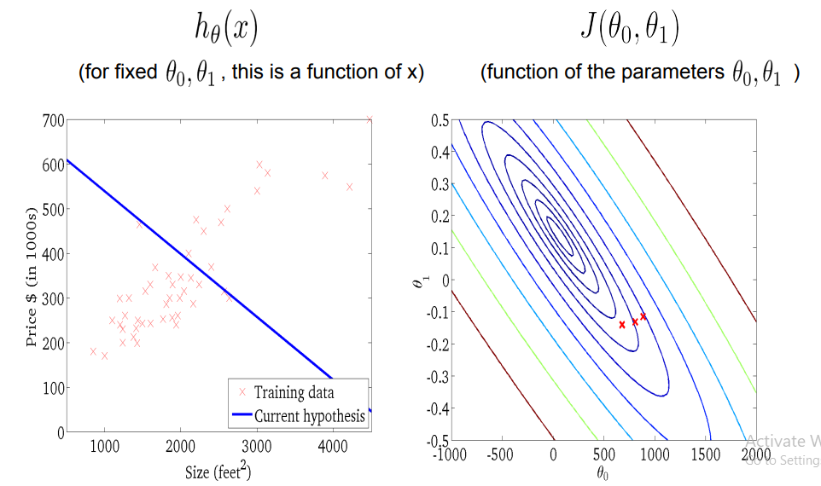
Linear regression with single variable

Slide 22
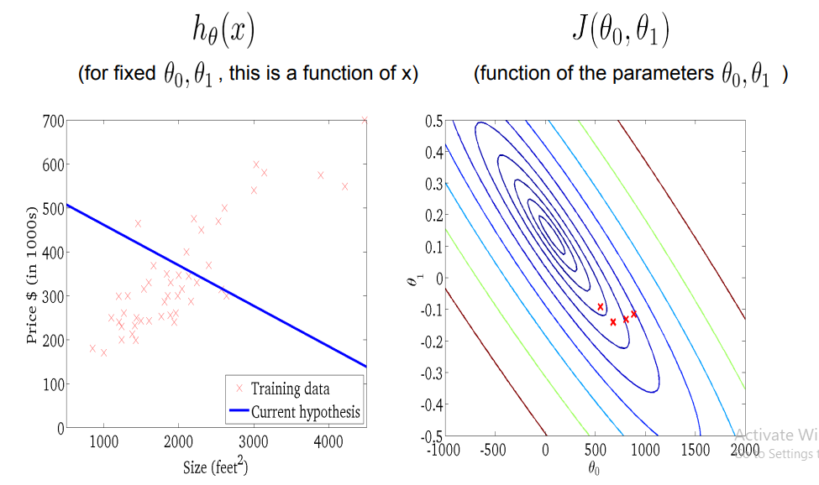
Linear regression with single variable

Slide 23
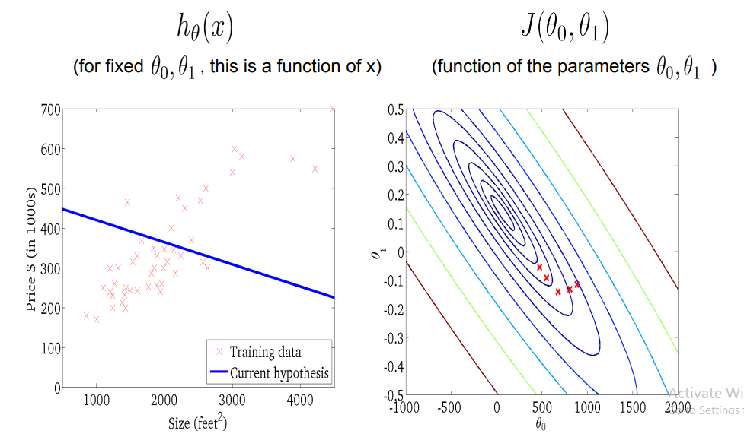
Linear regression with single variable

Slide 24
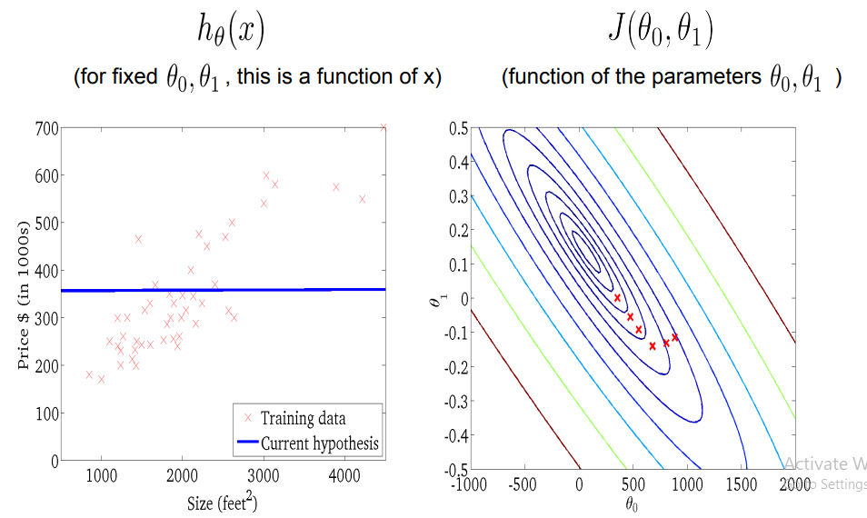
Linear regression with single variable

Slide 25
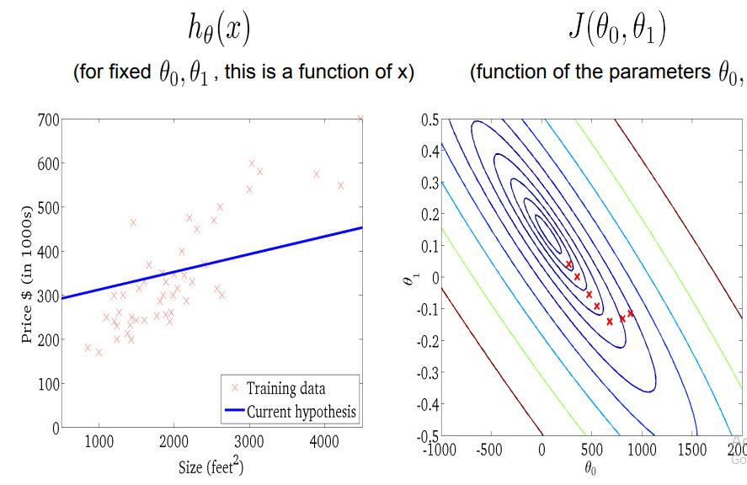
Linear regression with single variable

Slide 26
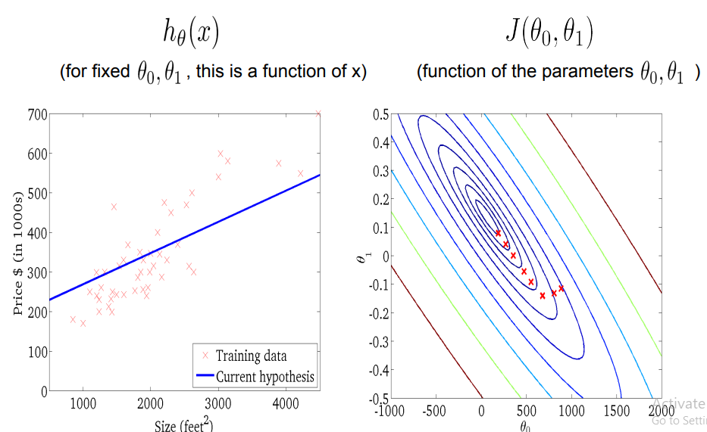
Linear regression with single variable

Slide 27
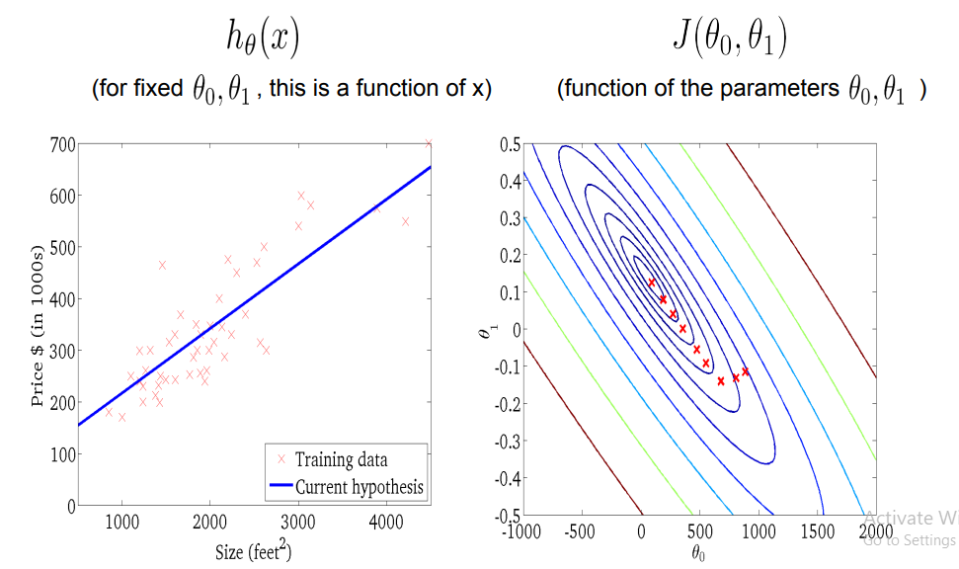
Linear regression with single variable

Slide 28
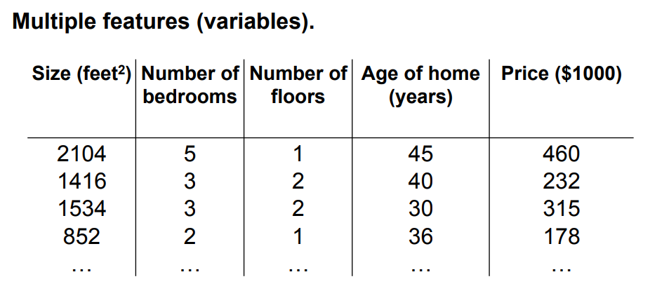
Linear regression with multiple variable

Slide 29
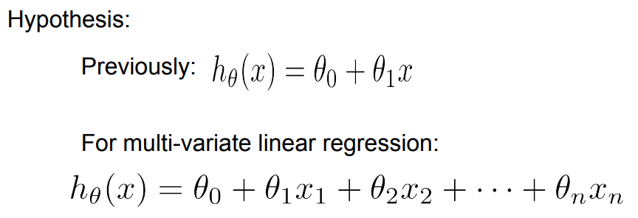
Linear regression with multiple variable

Slide 30
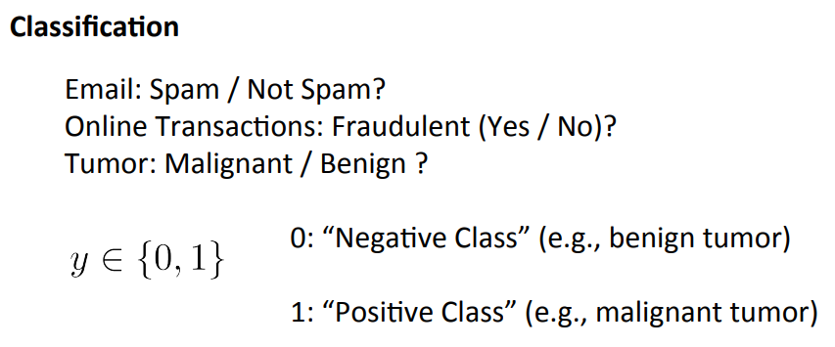
Classification by logistic regression

Slide 31
Classification
by logistic regression

Slide 32
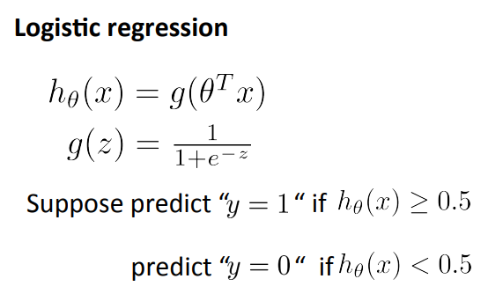
Classification by logistic regression

Slide 33
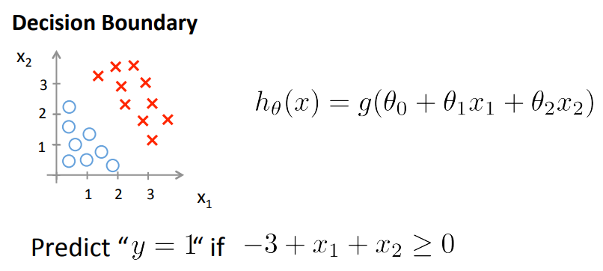
Classification by logistic regression

Slide 34
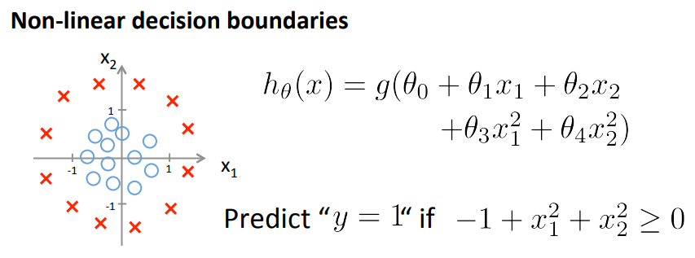
Classification by logistic regression

Slide 35
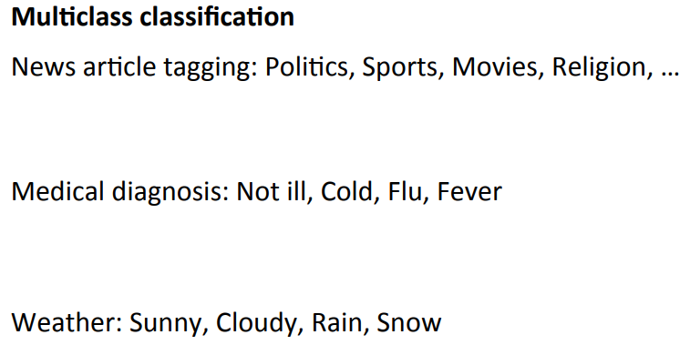
Classification by logistic regression

Slide 36
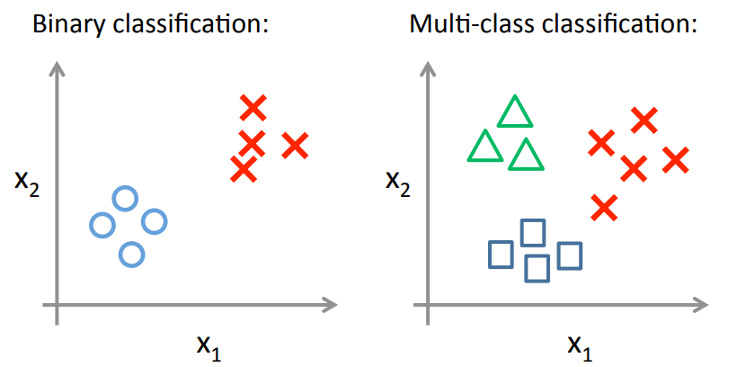
Classification by logistic regression

Slide 37
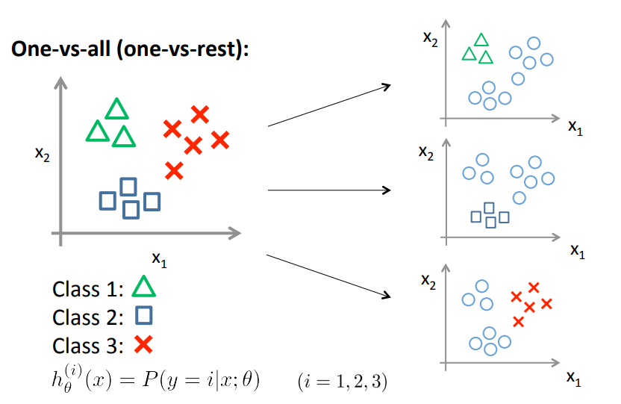
Classification by logistic regression

Slide 38
Neural networks

Slide 39
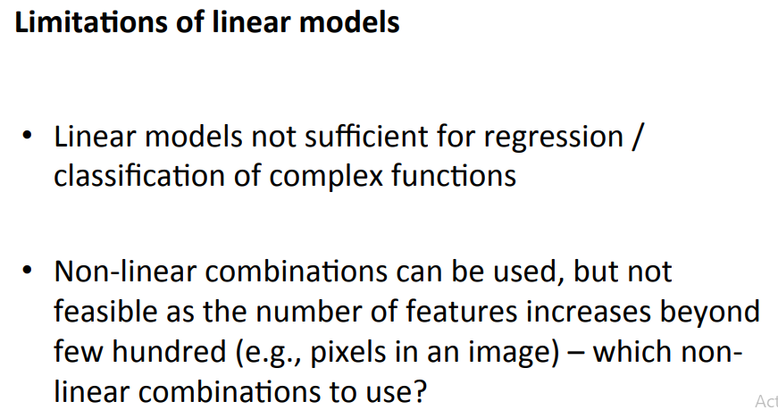
Neural networks

Slide 40
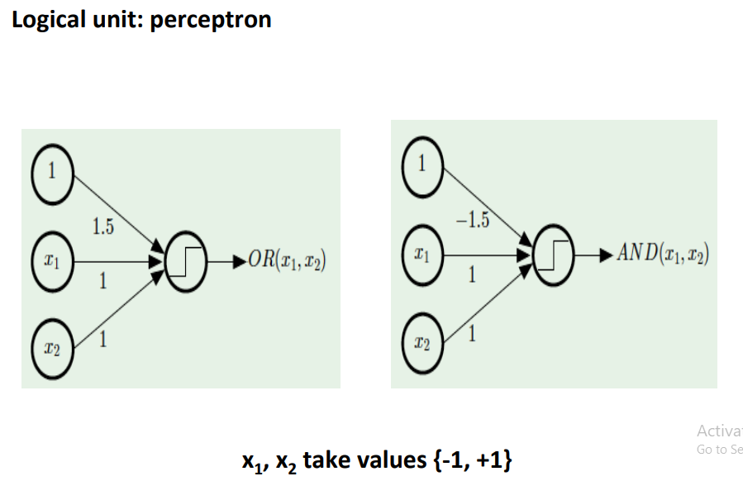
Neural networks

Slide 41
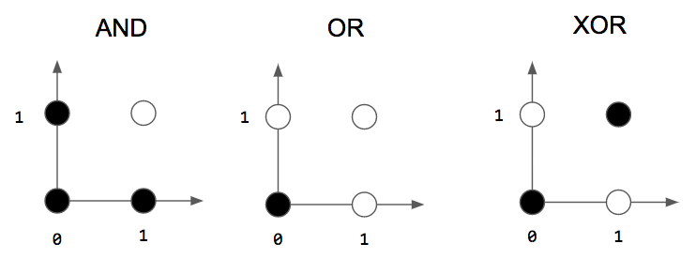
Neural networks

Slide 42
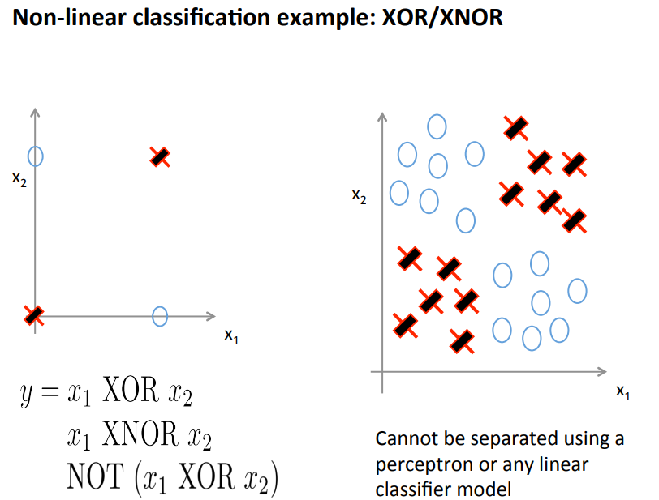
Neural networks

Slide 43
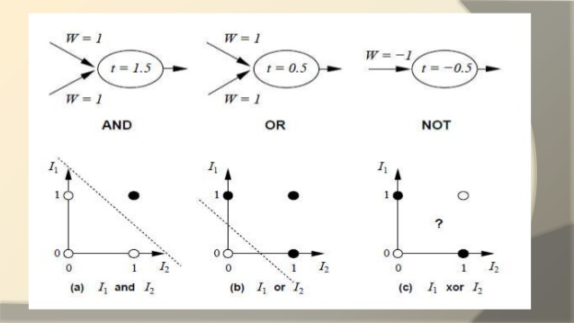
Neural networks

Slide 44
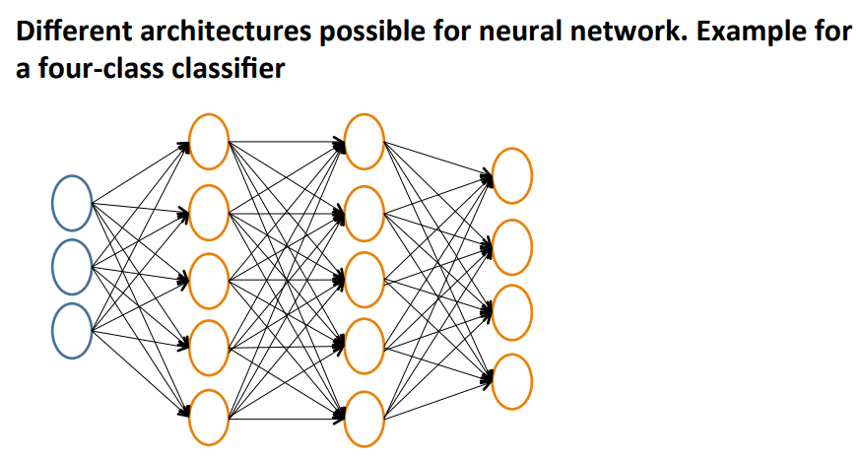
Neural networks

Slide 45
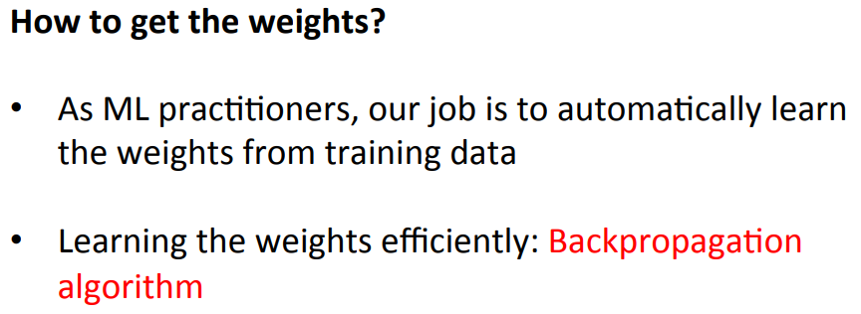
Neural networks

Slide 46
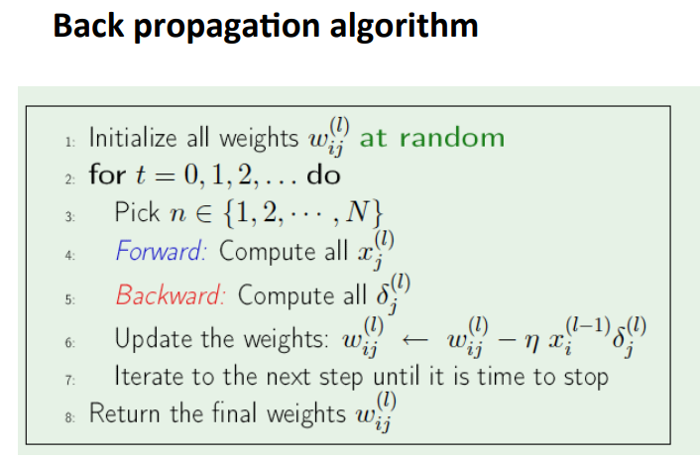
Neural networks

Slide 47
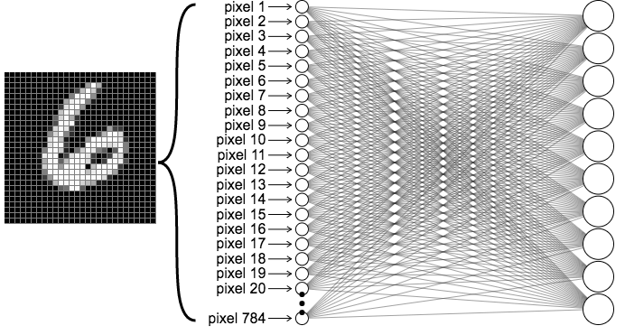
Neural networks

Slide 48
Thank you

Slide 49
My projects
ML - House price predictors
ML - Email spam/ham classifier
OpenCV - OMR to check answers
OpenCV & ML - Digital Convergence

